Slide 1
Matplotlib Overview

Slide 2
Installation :-
The best way to install it by using pip command:
pip install matplotlib

Slide 3
Line Chart :-
"A line chart or line graph is a type of chart which displays information as a series of data points called ‘markers’ connected by straight line segments."
Line graphs are usually used to find relationship between two data sets on different axis; for instance X, Y.

Slide 4
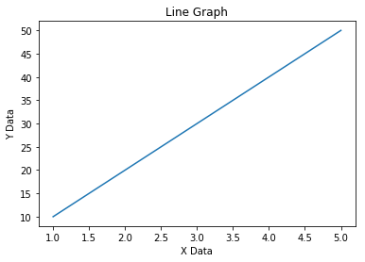
X = [1,2,3,4,5] Y = [10,20,30,40,50]

Slide 5
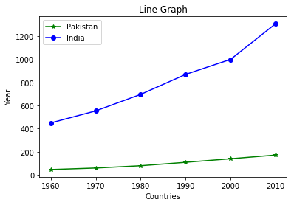
year = [1960, 1970, 1980, 1990, 2000, 2010]
pakistanPopulation = [44.91, 58.09, 78.07, 107.7, 138.5, 170.6]
indiaPopulation = [449.48, 553.57, 696.783, 870.133, 1000.4, 1309.1]

Slide 6
Pie Chart :-
"A Pie Chart is a circular statistical graphic which is divided into slices to illustrate numerical proportion"
Pie charts are good to show proportional data of different categories and figures are usually in percentages here.

Slide 7
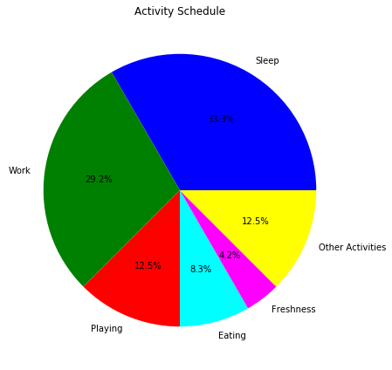
hours = [8,7,3,2,1,3]
activities = ["Sleep","Work","Playing","Eating","Freshness","Other Activities"]

Slide 8
Bar Chart :-
"A bar chart or bar graph is a chart or graph that presents categorical data with rectangular bars with heights or lengths proportional to the values that they represent."
The bars can be plotted vertically or horizontally.

Slide 9
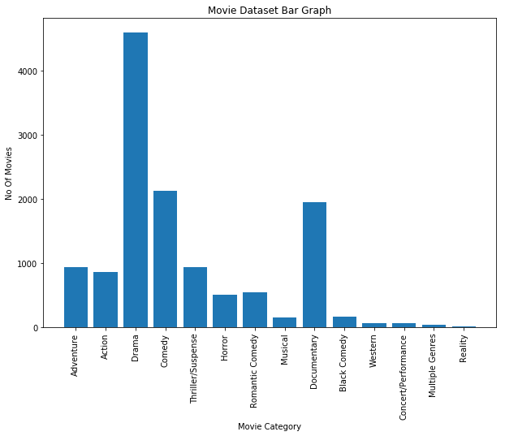
Vertical Bar Graph
X = ['Movie Category"]
Y = ["No Of Movies"]

Slide 10
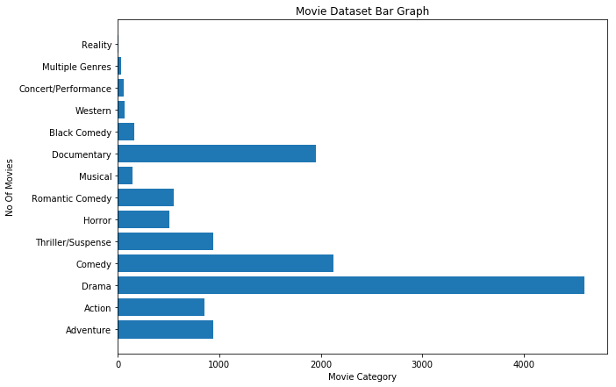
Horizontal Bar Graph
X = ['Movie Category"]
Y = ["No Of Movies"]

Slide 11
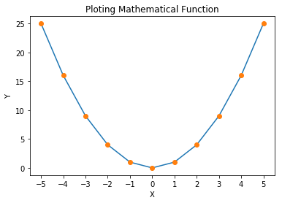
Ploting Mathematical Function
Y = X2

